Slide 1


JP Morgan Software Engineering Virtual Experience Internship Program Report
Name:-satvik pandey
Roll number:-22becse38
Computer science and engineering

Slide 2
Motivation
Participating in the JP Morgan Software Engineering Virtual Experience Internship Program was driven by my strong motivation to gain practical experience in the field of software engineering, particularly within the financial industry. The program offered a unique opportunity to work with a renowned institution like JP Morgan, known for its innovation and technological advancements in the finance sector.
There were several key motivations that fueled my desire to be a part of this program:
Industry Exposure
Skill development
Networking opportunity
Impressive reputation
Personal growth

Slide 3
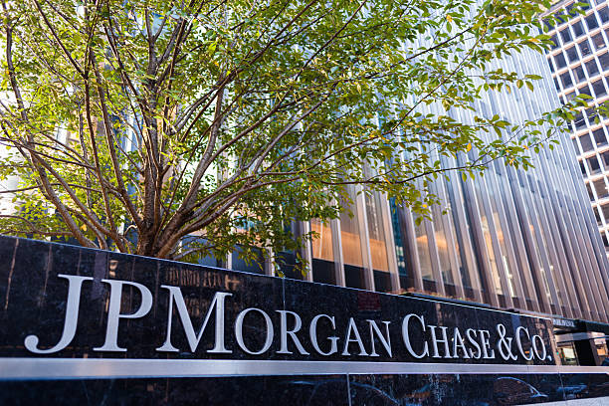
Introduction
This report provides an overview of my experience participating in the JP Morgan Software Engineering Virtual Experience Internship Program. Throughout the program, I completed three tasks that involved interfacing with the stock price data feed, utilizing JP Morgan's frameworks and tools, and visually displaying data for traders. This report will outline the tasks performed, the skills and knowledge gained, and the overall learning outcomes.

Slide 4
Objective
Three are three objective or task in this internship program:
Task 1: I want to process the data feed of stock A and stock B’s price to enable us to analyse when trading for the stock should occur.
Task 2:The objective of this task will be to fix the client-side web application so that it displays a graph that automatically updates as it gets data from the server application.
Task 3:You will use perspective to generate a live graph that displays the data feed in a clear and visually appealing way for traders to monitor.

Slide 5
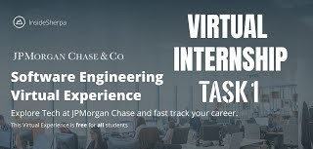
Task 1: Interface with the Stock Price Data Feed
The first task of the internship program involved interfacing with the stock price data feed. This task aimed to simulate real-world scenarios where software engineers need to access and manipulate financial data for analysis and decision-making. Using Python programming language, I developed a script to retrieve stock price data from the data feed provided by JP Morgan. This involved understanding and implementing data retrieval techniques such as RESTful APIs, JSON parsing, and data manipulation. By completing this task, I gained practical experience in working with real-time financial data and learned how to effectively retrieve and process it for further analysis.

Slide 6
Data retrieving techniques
RESTful APIs (Representational State Transfer):
Data Manipulation:
JSON Parsing (JavaScript Object Notation):
RESTful APIs are a set of architectural principles that define how web services should be designed and implemented. RESTful APIs enable communication between different systems over the internet by using standard HTTP methods like GET, POST, PUT, and DELETE. They are commonly used to retrieve and manipulate data from remote servers.
JSON is a lightweight data-interchange format that is commonly used for transmitting data between a server and a web application. JSON is human-readable and easy for machines to parse and generate. When I receive data from a RESTful API, it is often returned in JSON format.
Once i have retrieved data and parsed it into a usable format, I can perform various manipulations on the data based on our requirements. Data manipulation involves tasks such as filtering, sorting, transforming, aggregating, or visualizing the data.

Slide 7
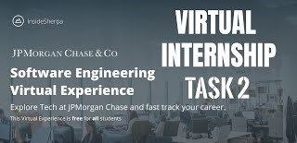
Task 2: Use of JP Morgan's Frameworks and Tools
The second task focused on utilizing JP Morgan's frameworks and tools. JP Morgan provides a wide range of software frameworks and tools that are used in the financial industry for various purposes, including data analysis, risk assessment, and algorithmic trading. During this task, I explored JP Morgan's proprietary tools and frameworks, gaining exposure to their functionalities and learning how they can be integrated into software development projects. Additionally, I familiarized myself with the best practices and guidelines provided by JP Morgan for efficient and secure software engineering.

Slide 8
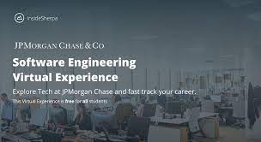
Task 3: Display Data Visually for Traders
The third task involved visually displaying data for traders. As part of this task, I developed a web application using JavaScript and HTML to present stock price data in an intuitive and visually appealing manner. I utilized JavaScript libraries, such as D3.js or Chart.js, to create interactive charts and graphs that enabled traders to analyze trends and make informed decisions. This task enhanced my understanding of web development frameworks and techniques for displaying data in a user-friendly manner.
Virtual internship task 3

Slide 9
Javascript libraries
D3.js (Data-Driven Documents):
Chart.js:
D3.js is a popular JavaScript library that provides a comprehensive set of tools for creating dynamic and interactive data visualizations on the web. It stands for Data-Driven Documents because it binds data to the Document Object Model (DOM) and enables me to manipulate and transform the DOM based on the data.
D3.js allows me to create a wide range of visualizations, including bar charts, line charts, scatter plots, maps, and more. It provides a low-level API for handling data and manipulating the DOM, giving me a complete control over the visual representation of my data.
Chart.js is a lightweight JavaScript library that focuses on creating beautiful and responsive charts and graphs. It simplifies the process of creating static and dynamic visualizations by providing a simple and intuitive API.
Chart.js supports various chart types, including line charts, bar charts, pie charts, radar charts, and more. It automatically handles aspects such as responsive resizing, tooltips, legends, and animations.

Slide 10
Learning Outcomes:
Frameworks:
Python Programming:
Display on Web Applications:
Through the internship program, I gained valuable insights into JP Morgan's frameworks, which are widely used in the financial industry. This experience provided me with a foundation for understanding the practical application of frameworks in real-world scenarios.
The internship program provided exposure to Python programming, which is widely used in data analysis and financial modeling. I gained hands-on experience in utilizing Python for retrieving and manipulating data, further strengthening my programming skills.
Developing a web application to display data visually enhanced my understanding of web development concepts, including JavaScript, HTML, and data visualization libraries. This experience equipped me with the necessary skills to create user-friendly and interactive interfaces for traders.

Slide 11
CONCLUSION
Participating in the JP Morgan Software Engineering Virtual Experience Internship Program was a valuable learning opportunity. The tasks completed during the program, including interfacing with the stock price data feed, using JP Morgan's frameworks and tools, and visually displaying data for traders, allowed me to gain practical experience and enhance my skills in frameworks, data retrieval, web development, and programming. This internship program has undoubtedly prepared me for future roles in software engineering within the financial industry, and I am grateful for the knowledge and skills acquired during this experience.

Slide 12
Reference
Here are some reference listed below from where I get brief description about several technique:
www.forage.com
www.google.com
www.geeksforgeek.com
www.jpmorganchaseandco.com

Slide 13
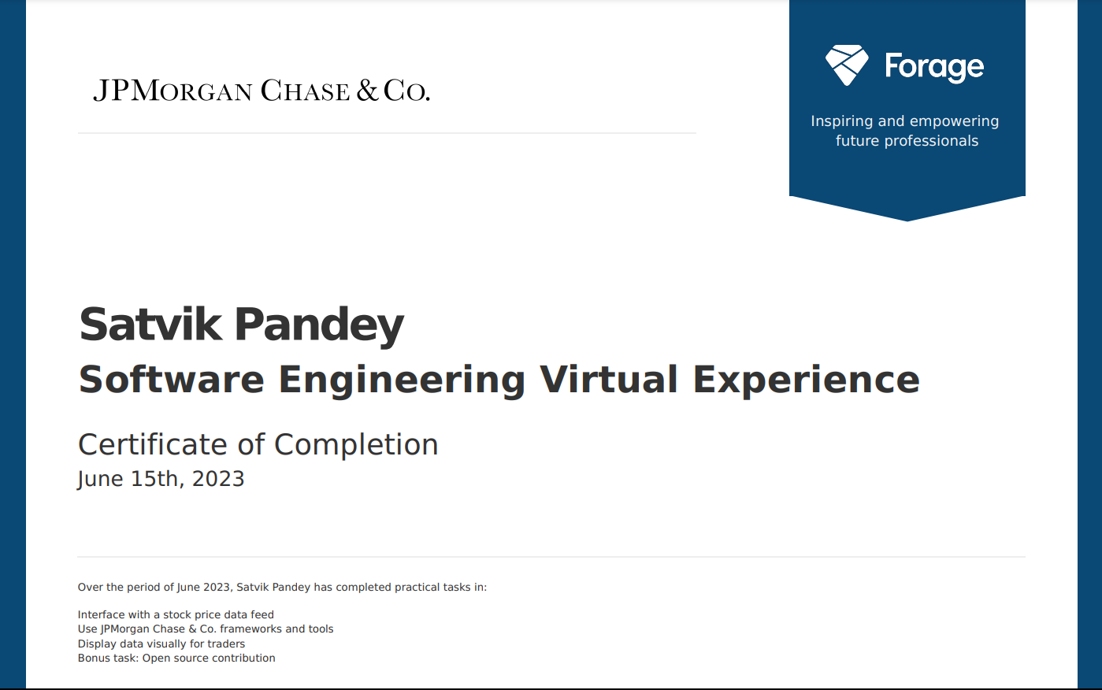
Completion certificate

Slide 14
Thank you

